Slide 1
SALES DATASET ANALYSIS
Anushiya. S
20-04-2025
Data Science and Data Analytics
March Online Evening 2025

Slide 2
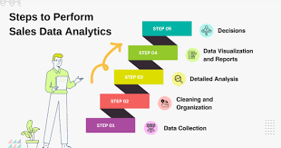
PROJECT OVERVIEW AND OBJECTIVES
“The Goal is to turn Data into Information, and Information into Insight”

Slide 3
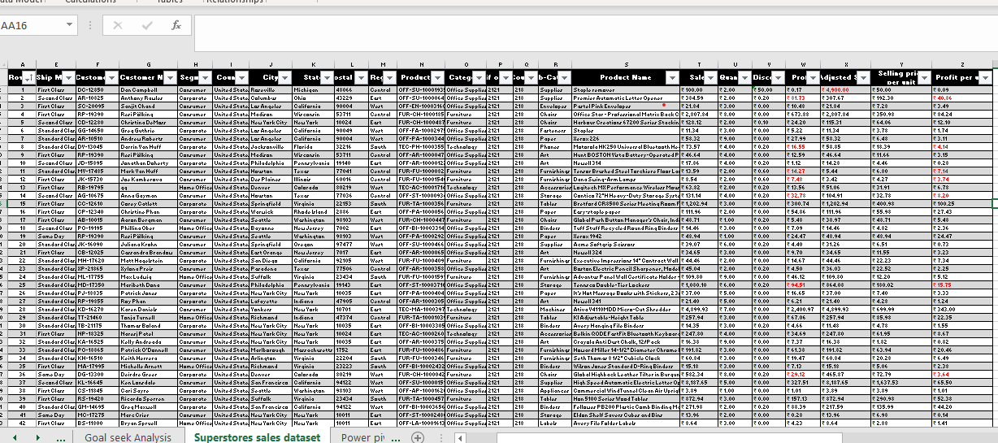
DATA DESCRIPTION AND PREPARATIONS
The SUPERSTORE Dataset is the sales dataset of 9500 rows and 25 columns. It is a complete dataset of different categories like Technology, Office supplies and Furnitures which compute sales, Discount and Profit margins.
Data Cleaning
1.Format cells(Alignment, Bold, Sort, Freeze Panes, conditional formatting)
2.Duplicate cells found and Removed, Blanks removed
3.Data validation(no negative values of sales and Profit)
4.IfError function
5.Outliers in sales and discounts

Slide 4
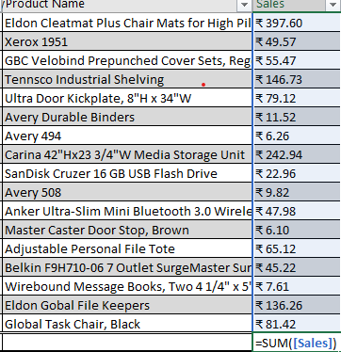
Key Matric Calculation
KEY METRIC AND CALCULATION AND DATA ANALYSIS
Total sales | =SUM([Sales])
Adjusted Sales | =Table1[@Sales]*(1-Table1[@Discount])
Average Sales per order | =AVERAGE(B5:B5013)
Average Discounts | =Average(Discount Column)
Average Oder value | =Sum(sales)/count(order ID)

Slide 5
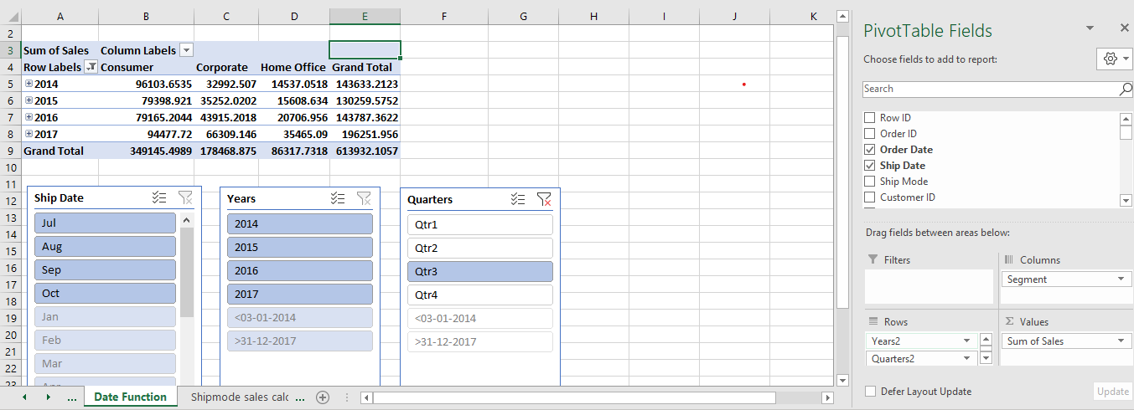
PIVOT TABLES AND CHARTS
A PivotChart is a graphical representation of the data summarized in a PivotTable.
-Select the dataset- select Insert pivot table-New worksheet-Select the required category.
Pivot chart creation – Select Pivot table created –Select Pivot chart

Slide 6
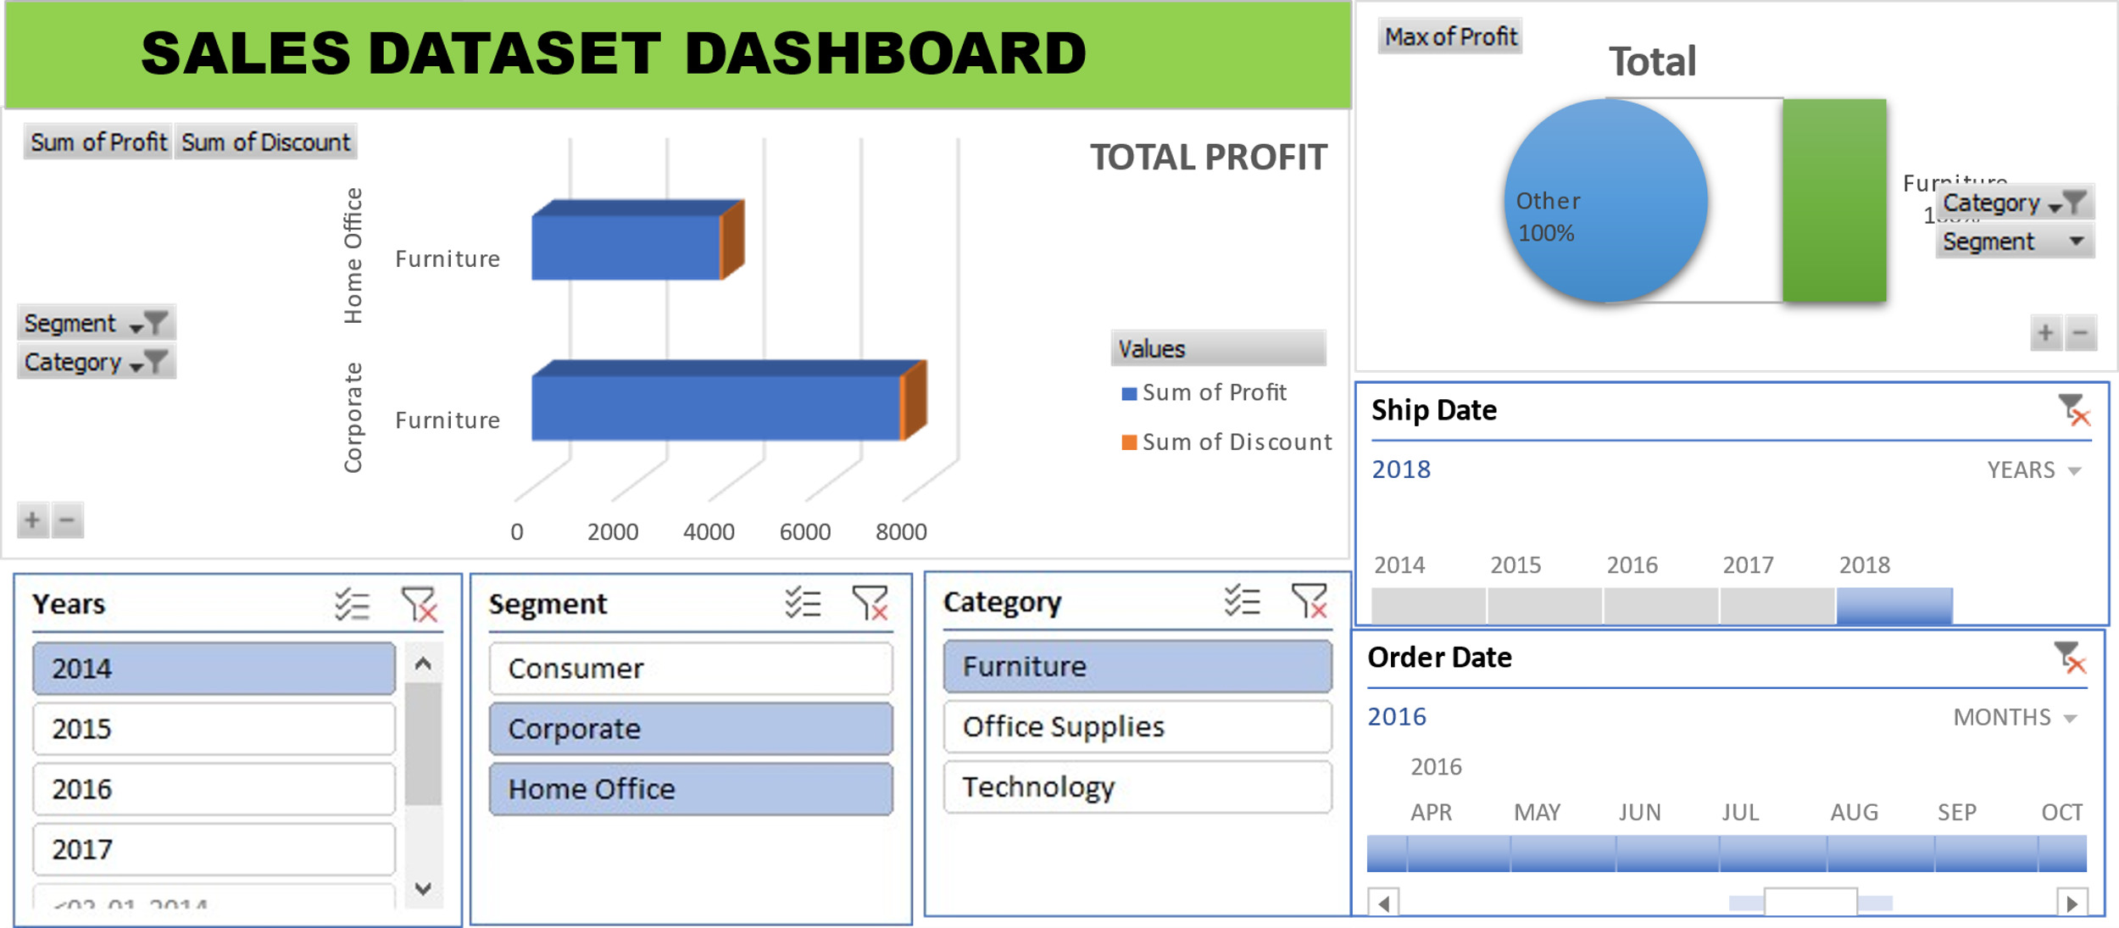
DASHBOARD OVERVIEW

Slide 7
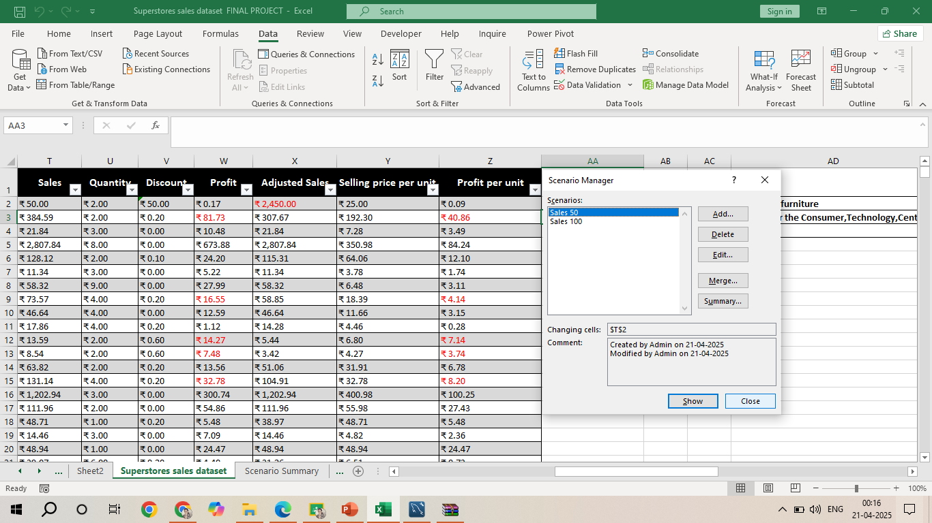
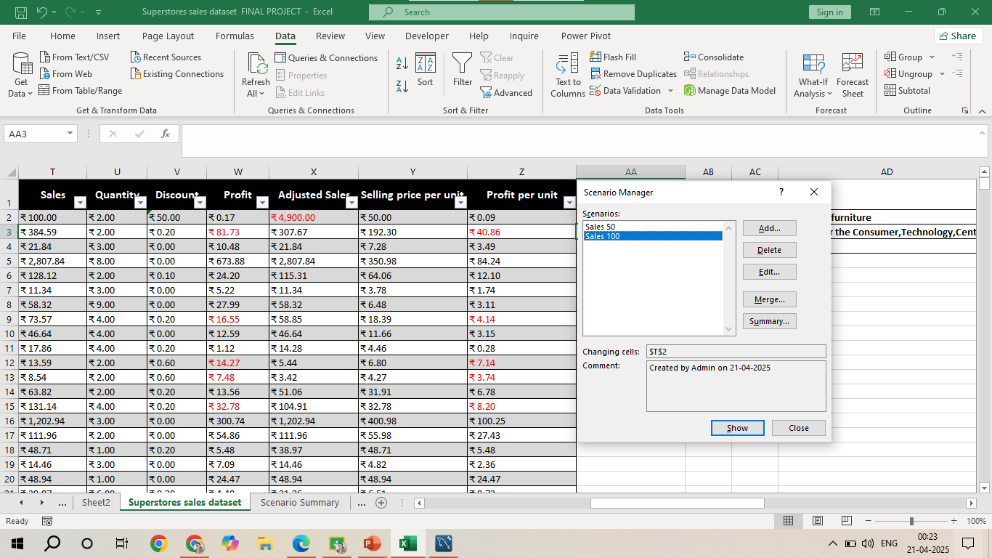
WHATIF ANALYSIS-SCENARIO
"What if" scenarios are hypothetical situations used to explore potential outcomes of different decisions or changes within a project, plan, or business strategy
WHATIF ANALYSIS-SCENARIO-ADD-SALES(50),ADD(100)-FOUND CHANGES IN ADJUSTED SALES AND SELLING PRICE

Slide 8
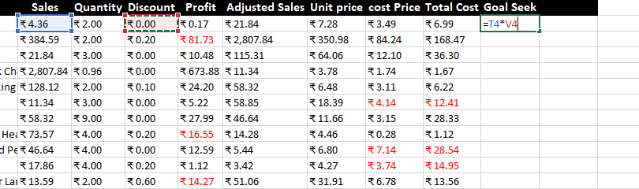
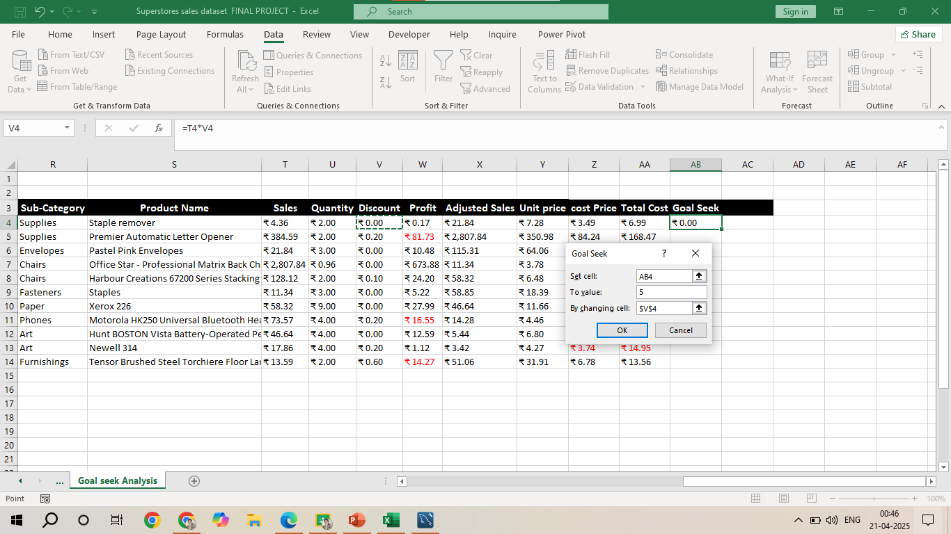
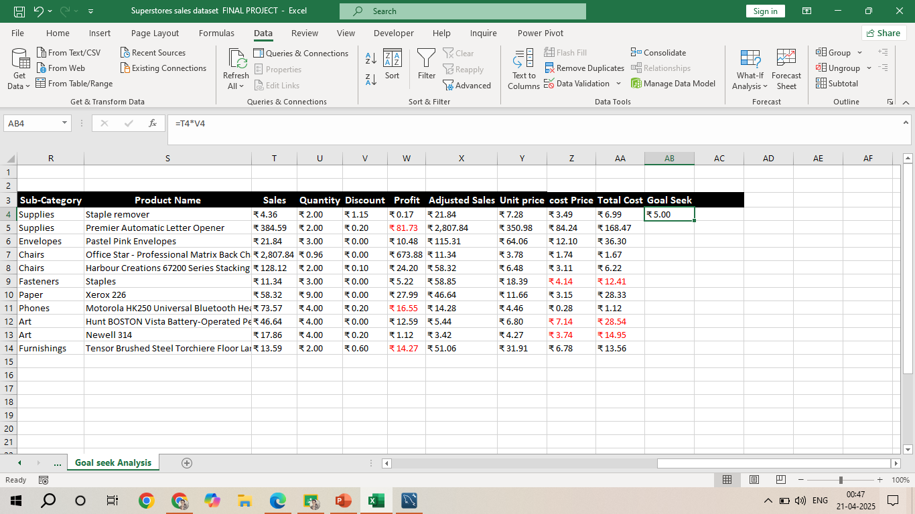
WHATIF ANALYSIS-GOAL SEEK
WHATIF ANALYSIS-GOAL SEEK-VALUE SET-VALUE CHANGES AS PER THE TARGET SET
Scenario Summary
 |  | Current Values: | Sales 50 | Sales 100
Changing Cells:
 | $T$2 | ₹ 100.00 | ₹ 50.00 | ₹ 100.00
Result Cells:
 | $BF$9985 | ₹ 197.09 | ₹ 197.33 | ₹ 197.09
 | $X$9996 | ₹ 19,69,714.37 | ₹ 19,72,164.37 | ₹ 19,69,714.37

Slide 9
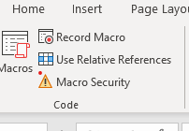
MACROS AND AUTOMATION
GO TO DEVELOPER-
RECORD MACROS
PERFORM FUNCTION
STOP RECORDING
RUN THE REQUIRED MACRO.
Benefits of Macros
Automation: Macros can automate repetitive tasks, saving time and effort.
Efficiency: They streamline workflows by performing actions quickly and accurately.
Error Reduction: By automating tasks, macros help minimize the risk of human errors.
Flexibility: Macros can be used to customize and tailor processes to specific needs.
User-Friendly: You can create macros without extensive programming knowledge.

Slide 10
INSIGHT AND RECOMMENDATIONS
Key Insights: Summarize the most important insights from the analysis, such as:
Best-performing sales channels/products.- Technology(Slide 6)
Trends in discounting and its impact on total sales. – what if analysis-Goal Seek is computed.(Slide 8)
Seasonal sales variations or peak performance times.-Power query
Recommendations for improving sales based on analysis –Can Promote High performing product, Reward repeat customers, Streamline Inventory.
(e.g., reduce returns, increase discounts on underperforming products).

Slide 11
CONCLUSION AND QUESTIONS
SUMMARY
Boost Promotion During Peak
Discounts for underperforming Products
Investigate on High return Products
Focus on Best sellers
NEXT STEPS FOR FUTURE INSIGHT
Collect more Detailed Data
Track Customer Lifetime value
QUESTIONS?

Slide 12
THANK YOU

